Slide 1
Projeto web : angular
Alunos : Rodolfo hugo e Mayra nunes

Slide 2
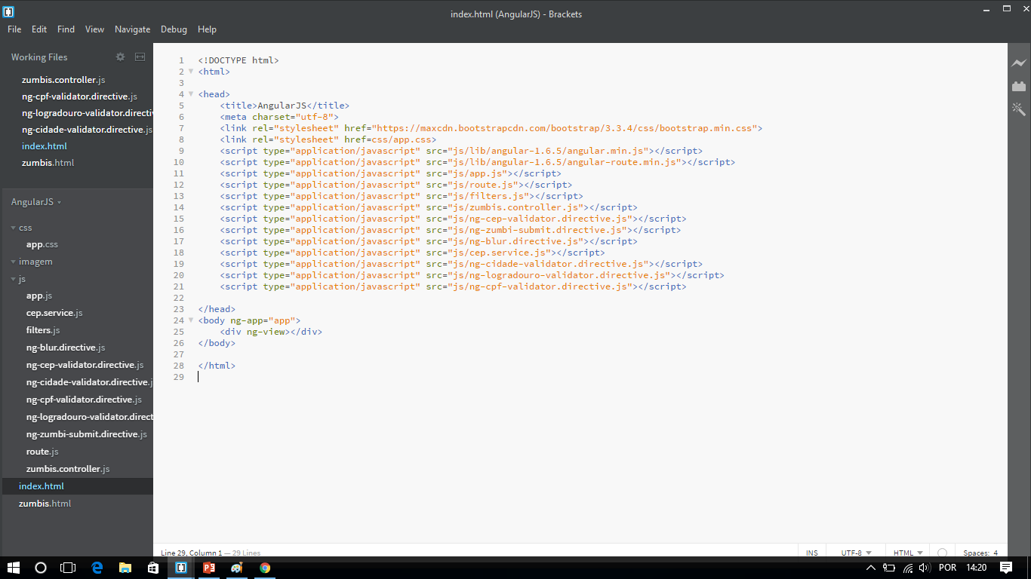
INDEX.HTML

Slide 3
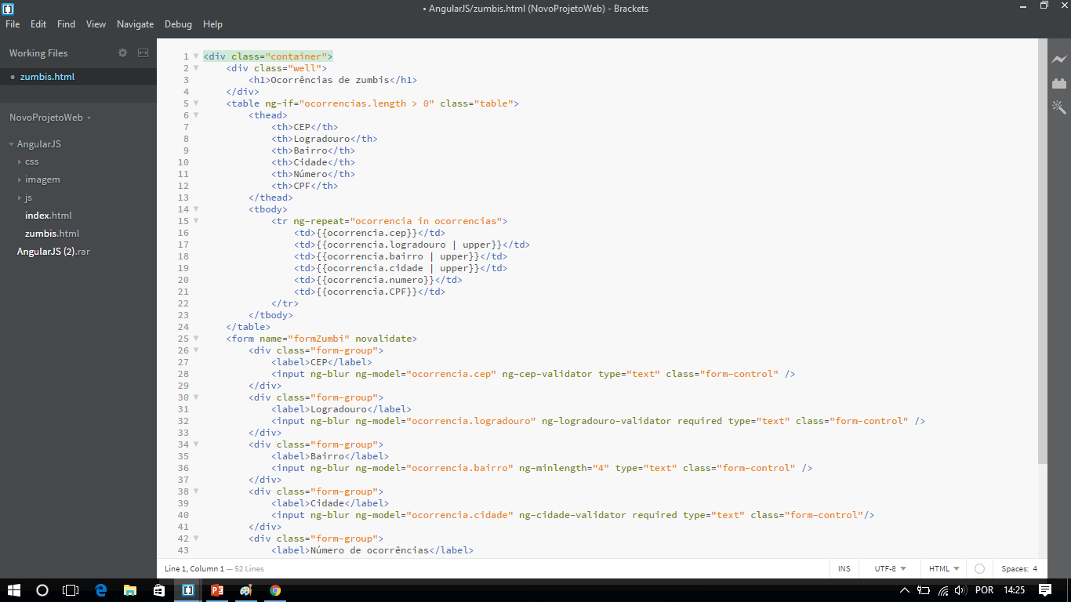
zumbis.html parte 1

Slide 4
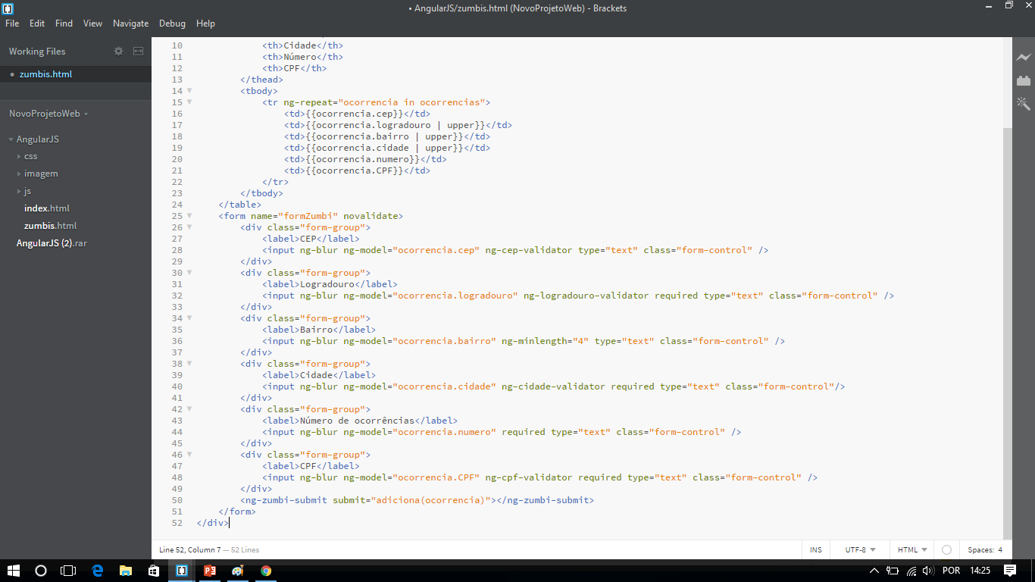
Zumbis.html parte 2

Slide 5
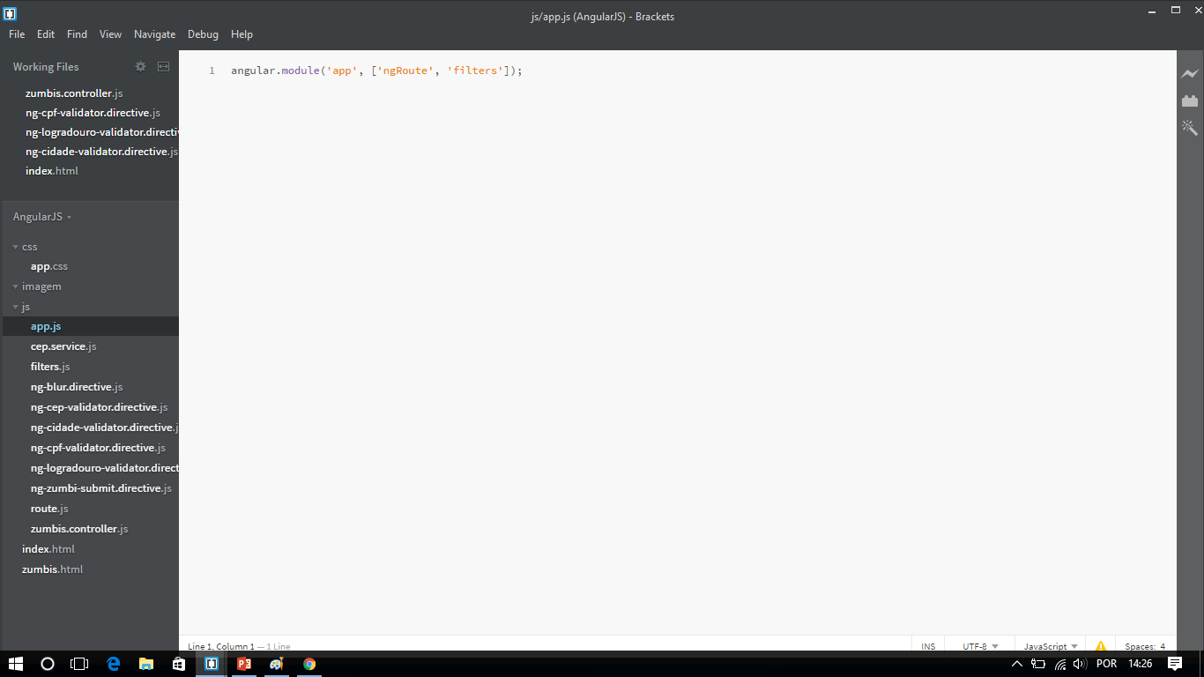
app.js

Slide 6
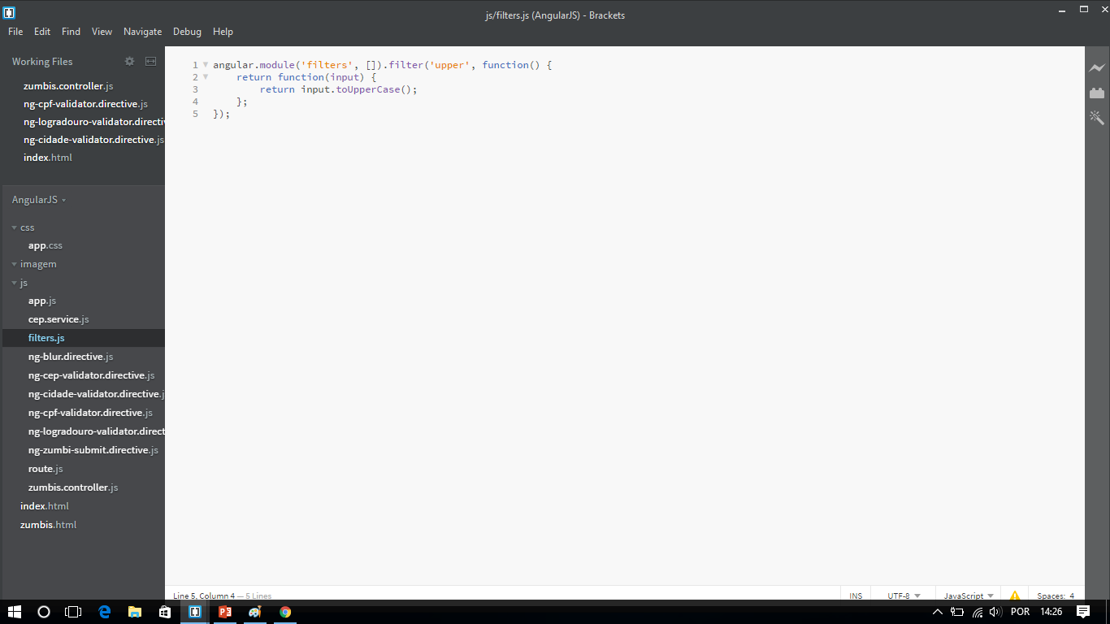
filters.js

Slide 7
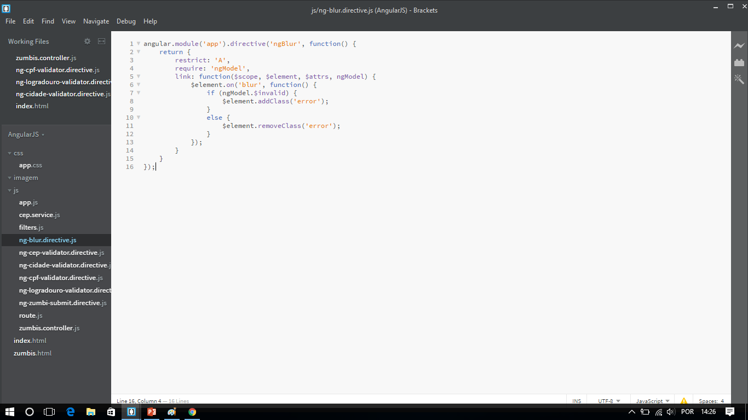
Ng-blur.directive.js

Slide 8
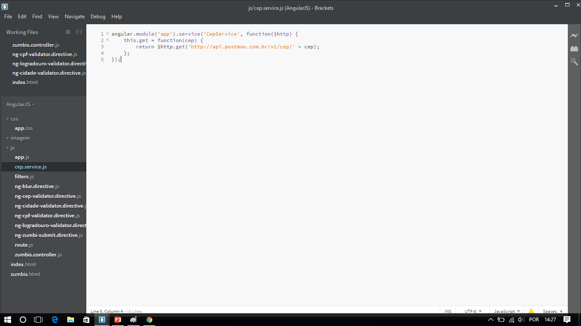
Cep.service.js

Slide 9
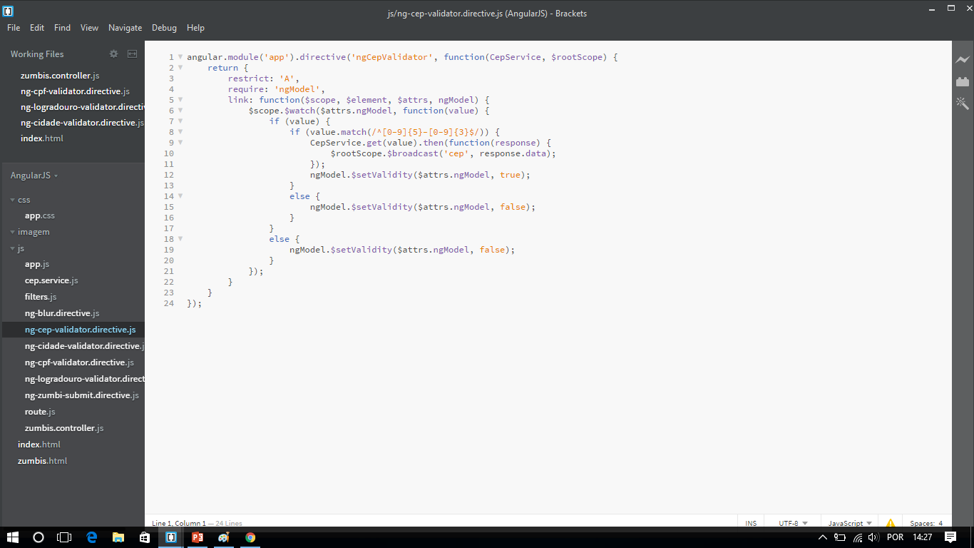
Ng-cep-validator.directive.js

Slide 10
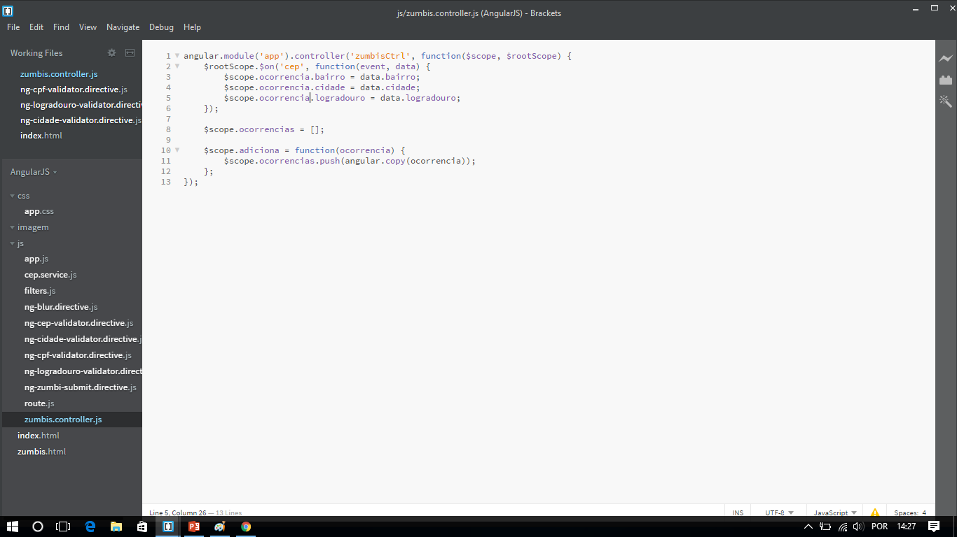
Zumbis.controller.js

Slide 11
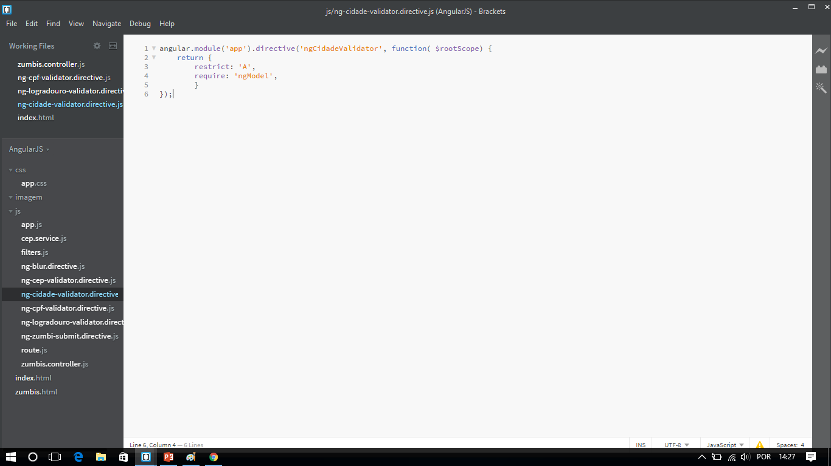
Ng-cidade-validation.directive.js

Slide 12

Ng-logradouro-validation.directive.js

Slide 13
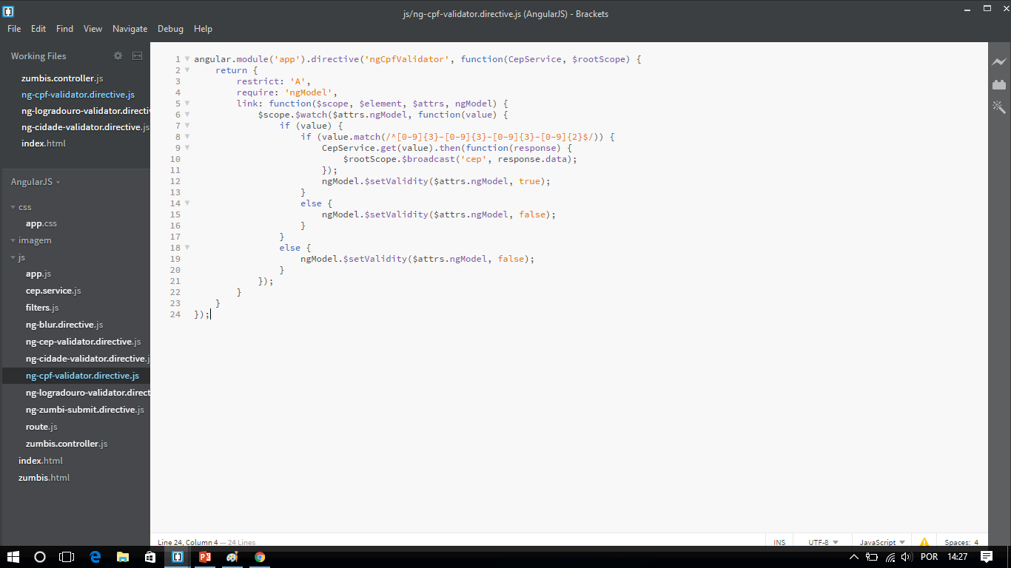
Ng-cpf-validation.directive.js

Slide 14
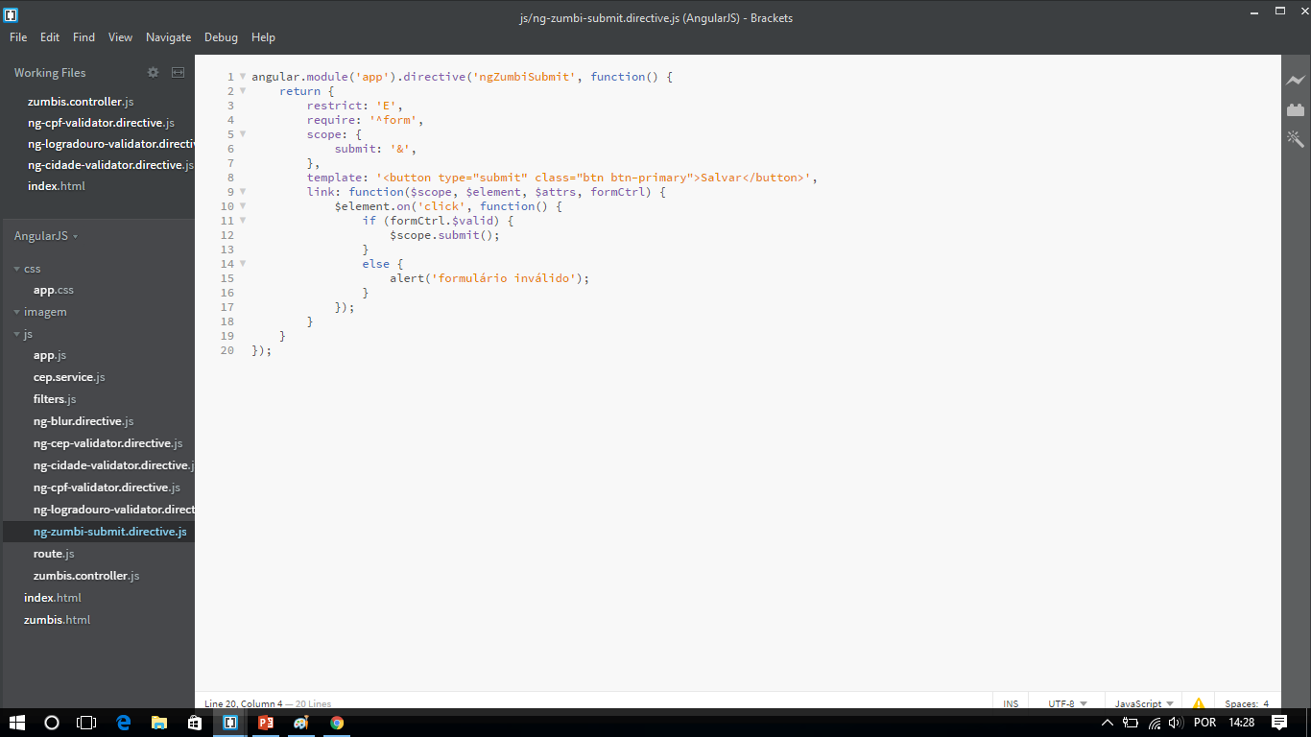
Ng-zumbi-submit.directive.js

Slide 15
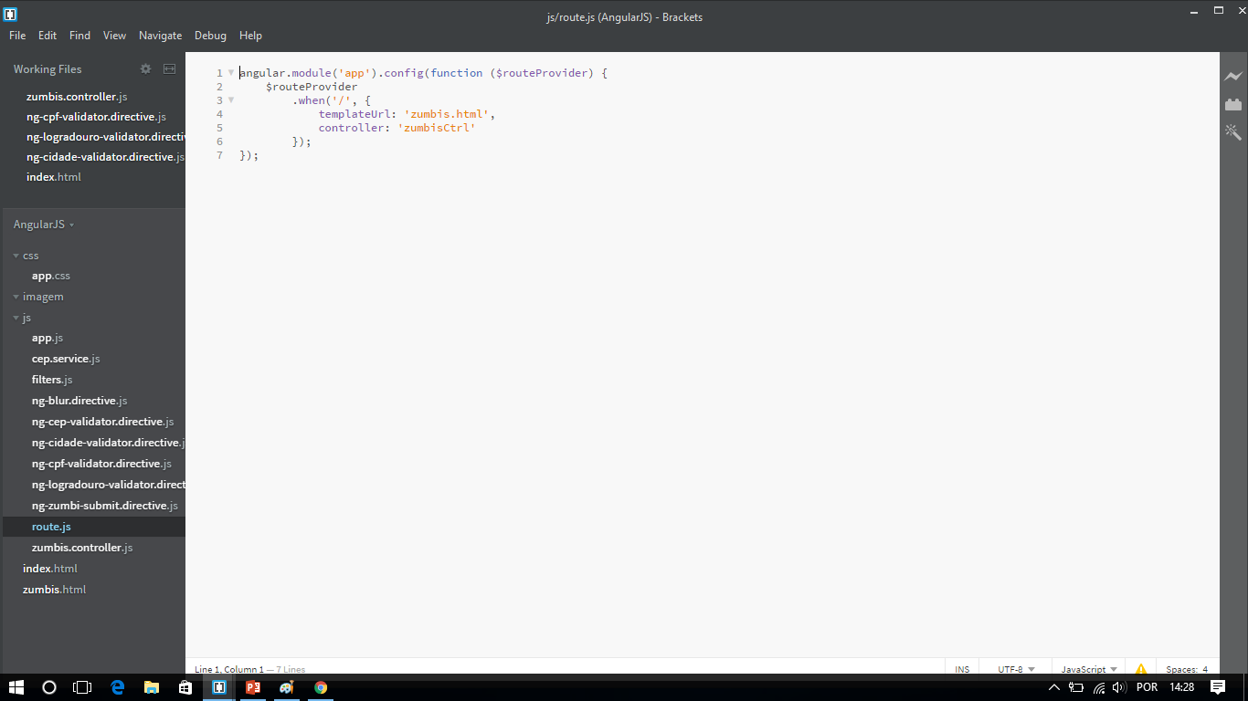
Route.js

Slide 16
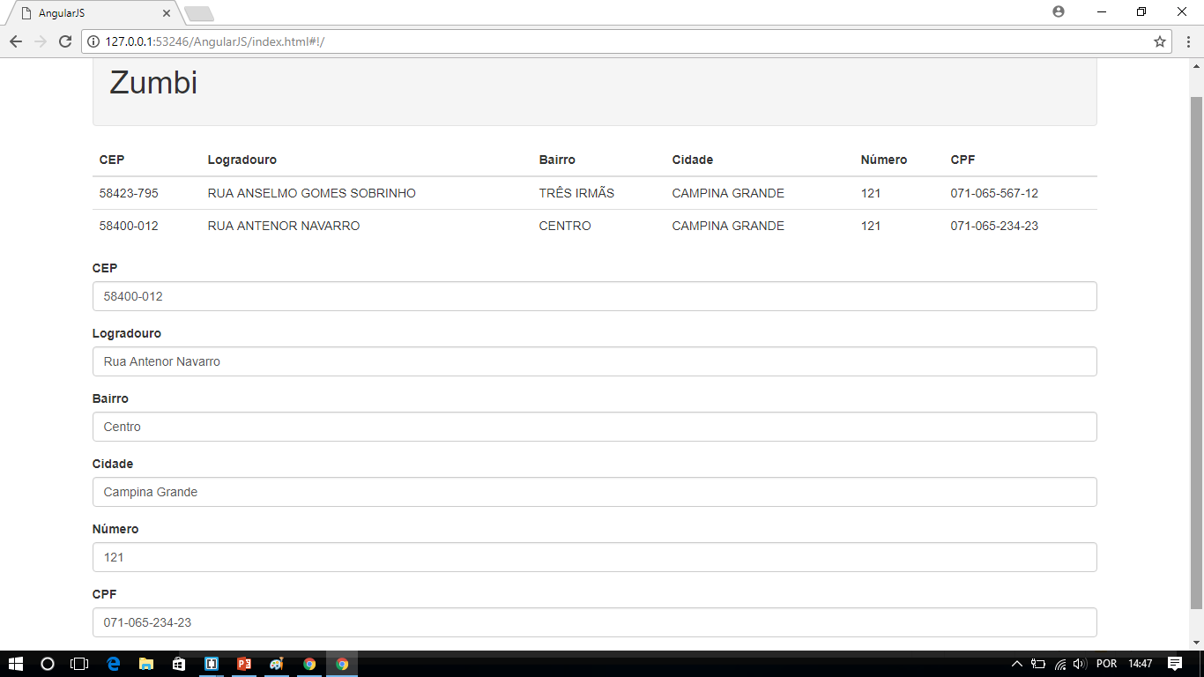
Código

Slide 17
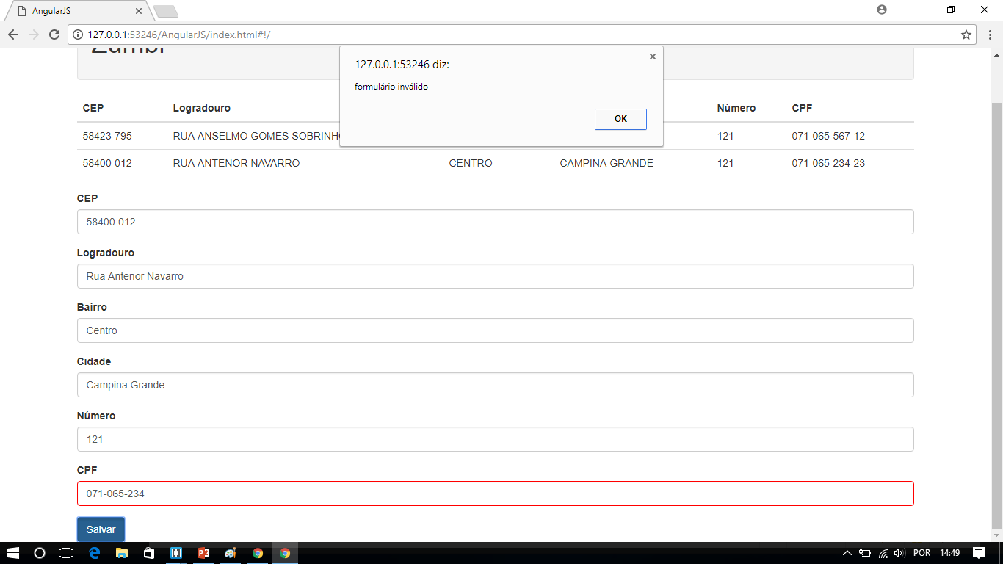
Erro

